Slide 1
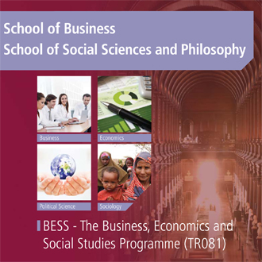
Dr Michael Wycherley
Academic Director of BESS

Slide 2
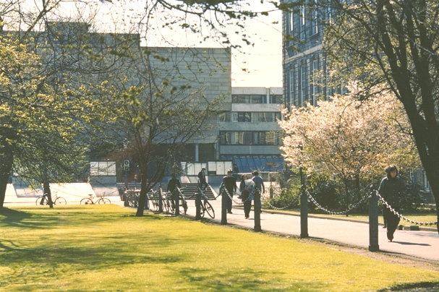

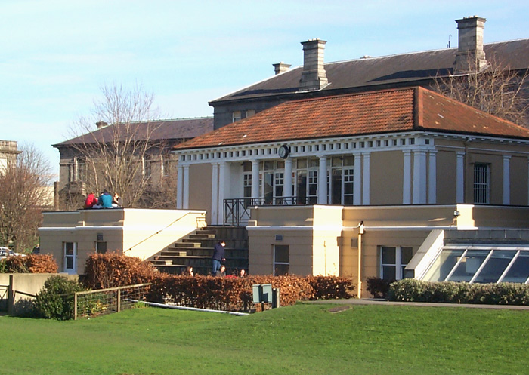
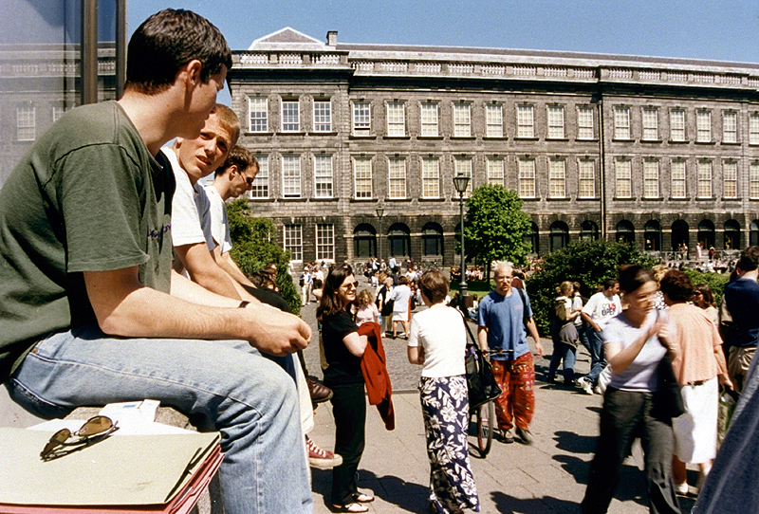
Trinity College…. Founded in 1592
A University of Global Consequence
Notes:
The leading Irish research university
Global recognition
Ranked 1st in Ireland and 129th in the World (QS 2014 71st in world and 25th in Europe)
A community of Scholars
Nobel prize winners
Beckett, Shaw, Walton
For the purpose of compiling the rankings, 5,100 academics from around the world were surveyed concerning the research quality of the university and their views accounted for 40% of the score. In addition, 1,480 international employers in a recruiter review were surveyed concerning their views on graduate employability which accounted for 10%. The other half of the marks was made up of teaching quality which was measured by staff: student ratio (20%), a further 20% was allocated to research quality which was gauged by the university’s citations of major papers. The international outlook was also measured by international faculty staff (5%) and international students (5%). Trinity College scored highly in all of these categories.

Slide 3




BESS: A multi-School Programme
School of Business
School of Social Sciences and Philosophy
Notes:
Strong international research reputation
Excellent links to Irish and global organisations in the private, public and voluntary sector
Active alumni: Trinity Business Alumni
Range of Undergraduate programmes: BESS/BBS, Business & Language, Computer Science & Business, Law & Business
Gain an understanding of the role of management and organisation in society and knowledge of:
marketing, finance, accounting, entrepreneurship, strategy, human resources, innovation, operations, information systems and many more.
Comprises the Departments of Economics, Philosophy, Political Science and Sociology
The School is at the forefront of teaching and research in Ireland across its four Disciplines

Slide 4
WHAT IS BESS?
Business
Economics
Political Science
Sociology
Notes:
Gain an understanding of the role of management and organisation in society and knowledge of:
marketing, finance, accounting, entrepreneurship, strategy, human resources, innovation, operations, information systems and many more.
The scientific study of politics, the exercise of power and the workings of democratic political institutions

Slide 5
What does BESS offer?
Only university degree where students can combine the study of Business, Economics, Political Science and Sociology
Flexible programme with 10 different degree options across these four subjects
BESS graduates are highly sought-after in the fields of business, government, technology, media and academia
Opportunity to study abroad at distinguished international universities

Slide 6
Degree options in BESS
Business
Economics
Political Science
Sociology
Business & Economics
Political Science & Sociology
Economics & Sociology
Business & Political Science
Sociology & Business
Economics & Political Science
Single Honors
Joint Honors
Notes:
Explore the world of business and management
Study subjects including marketing, management, human resources, innovation, strategy, entrepreneurship, accountancy and many more.
Economics
Develops the concepts and tools to understand:
How to limit / prevent unemployment
How to regulate financial markets
How to control the market power of large firms
How best to address climate change
How to help poorer countries grow and develop
The scientific study of politics, the exercise of power and the workings of democratic political institutions
Students will learn about
How democracy works
How people vote
How political parties compete
How European integration works
The values behind political ideologies
Understand phenomena such as
Social change and how it affects your own life and that of others
Shared practices of behaviour
Social movements like fair trade or feminism
Inequality at global and local levels
The nature and meaning of work

Slide 7

What will I study?
Each year students study a set number of modules, undertaking 60 ECTS per year
First year gives an introduction to the four core disciplines
In the second year you learn the key foundational skills of your chosen discipline(s)
Specialisation in the third and fourth years, allowing you to choose areas of interest within your second year disciplines
Opportunity to study abroad in third year

Slide 8
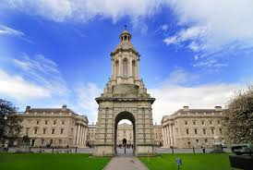
Junior Freshman – 1st Year
  Fundamentals of Management and Organisation
  Introduction to Economics
  Introduction to Political Science
  Introduction to Sociology
  Mathematics and Statistics
  Another module of your choice (Language, Law or Social Policy)
    Submit to Course Office asap
    In case of a change of mind notify the
    Course Office by the end of week 2
    (Friday 7th October 2016).

Slide 9
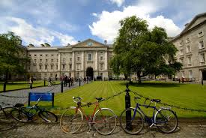
Senior Freshman – 2nd Year
Choose your degree pathway
Option to continue with Language module
Broad Curriculum module option
Foundation Scholarship

Slide 10
Choice of SF modules
Determines your possible degree pathways for the rest of your time in Trinity.
To do Single or Joint Honors Sociology or Political Science you must do 20 specific credits in the relevant discipline
To do Single or Joint Honors Economics you must do 30 specific credits in Economics.
To do Single Honors Business you must do 30 specific credits in Business and 10 in Economics
Notes:
So it is possible to keep open the option of Single or Joint honors in any two of the BESS disciplines
Or you can commit to take a wider range of modules in the SF year at the cost of committing to a single honors degree pathway from the start of the SF year

Slide 11
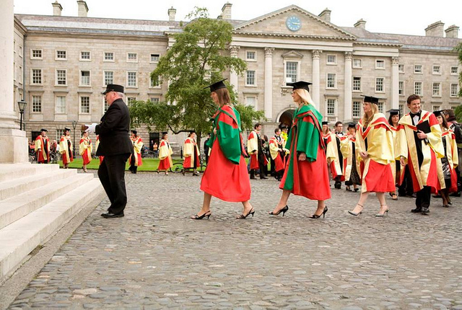
Junior & Senior Sophister
3rd & 4th Year
Specialise in one (Single honor) or two (Joint honors) subjects
Option to undertake an undergraduate dissertation in the final year
Ordinary (3rd Year) or Honor (4th Year) degrees
Careers or continuing education information sessions provided

Slide 12

The Trinity Experience
Wider student life is important, and BESS seems to provide plenty of scope for engagement in a wide range of activities
Some societies seem particularly suited to BESS Students
E.g.
  DUBES – Dublin University Business & Economic Society
  Political Science Society
  Social Studies Society
  AIESEC
  Foresight
  Enterprise Trinity
  Upstart
  Mature Students Society
  Think something is missing? Set it up yourself!
Notes:
Foresight: business school: forum to meet businessmen
Enterprise: supports start ups
Upstart: entrepeneurs

Slide 13

We are here to help!
Programme website www.tcd.ie/bess
Programme Handbook
Programme Administration
Programme Director
Your Module Lecturers
Module Teaching Assistants
Your College Tutor
Mathematics Help Room

Slide 14

Frequently Asked Questions
Visit www.tcd.ie/bess/current-students/faq to find out...
  How do I contact my lecturers
  How do I get my results for my assignments?
  Where can I find out about going on exchange?
  Are there exemptions for accountancy exams?
  How do I apply for a transcript
  How to access student supports

Slide 15

Programme Administration
Course Office
  Course Administrator: Martina Ní Chochláin
  Room 3023, Level 3, Arts Building
  Open every day
  Call by in person
  Email bess@tcd.ie (giving your student no.)
  Telephone 01- 8961298

Slide 16
Important BESS rules (1)
Lectures and tutorials are compulsory
  Students with significant level of absenteeism can be deemed non-satisfactory (“NS”) and prevented from sitting final examinations
Some tests may take place during Michaelmas and Hilary Terms.

Slide 17
Important BESS rules (2)
What to do if you are ill for tests and/or examinations?
  Absences are excused only with a medical certificate or equivalent (communicate with/via your College Tutor)
  Absence is not the same as getting zero. Do not just not turn up.
  The assumption is that if you sit an exam then you were healthy. Typically it is not possible to claim illness after an exam.
What to do if you are unable to submit an assignment on schedule?
  Contact your tutor and the lecturer concerned, preferably before the deadline.

Slide 18
Attending lectures?
“Expected” grade=> | I | II.1 | II.2 | III/Fail | Total
Virtually all (> 90%) | 43% | 49% | 29% | 14% | 30%
Most (> 66% but < 90%) | 43% | 35% | 46% | 42% | 40%
Around half (> 33% but < 66%) | 14% | 14% | 21% | 32% | 24%
Not many (> 10% but < 33%) | 0% | 3% | 1% | 6% | 3%
Hardly any (< 10%) | 0% | 0% | 1% | 0% | 1%

Slide 19
Making your voices heard
The BESS programme is administered by the BESS Programme Committee, on which a student representative sits
SU elections for class representatives who meet with individual Department Heads on a regular basis
Evaluation of modules by students occurs at the end of Hilary and Michaelmas terms (http://www.tcd.ie/ssp/undergraduate/student-evaluations/YouSaid_WeDid.php)
Problems with a module? – in general, if possible bring it up with the module lecturer in the first instance
Individual/personal problems? – discuss with your College Tutor and there’s also the counselling service and S2S.

Slide 20
What happens next week?
Two one-hour lectures in each of the six modules
In the first lecture the requirements and rules of the module will be explained, so make sure you go.
No seminars or tutorials in week 1
  Seminar/tutorial groups assigned via SITS by the end of week 1
  In exceptional cases, you can request a change of tutorial group by contacting the relevant departmental office (not the Course Office)

Slide 21
Next Week: Lectures
All in the Ed Burke Theatre in the Arts Building
BU1511 Mon 12 & 1,
EC1010 Thurs 12 & 1,
PO1600 Wed 5 & Fri 9,
SO1310 Tues 11 & Thurs 5,
EC1030 Wed 12 & Fri 10,
For optional modules consult SITS (which should have your complete timetable once registered)

Slide 22

In the near future……
Make contact with your College Tutor
Make contact with S2S
Maintain steady progress with your modules
Check your email regularly (communication from the Course Office will be via your TCD email address only)
Get to know your classmates

Slide 23
Dr Michael Wycherley
Academic Director of BESS
And Finally….
Enjoy your studies on the BESS Programme at Trinity College Dublin

